Slide 1
Collidium
Seattle Collision research tool

Slide 2
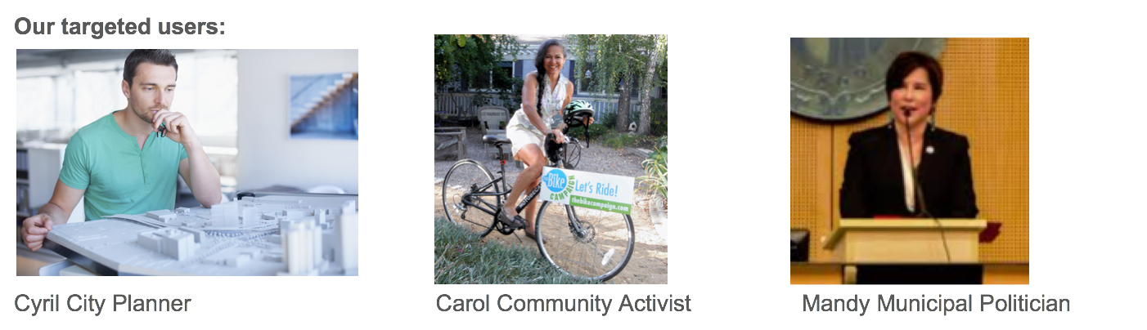
We are developing five use cases for our targeted users
Collidium: Seattle collision research tool
Each of these users wants information to help them support their agenda. Their priorities are:
Information is presented in a way that is easy to interpret
They can select options to focus on the questions that are most interesting to them

Slide 3
Use Cases
Collidium: Seattle collision research tool
Each of our use cases allows users to see visualizations of data that is filtered in different ways. These include:
Time frame of construction: “I want to see how collisions increased around buildings built in 2016”
Building type: “I want to see how multifamily construction affects collisions. Now I just want to look at commercial construction”
Accident victims: “I only want to see accidents that involve pedestrians or cyclists”
Accident severity: “I only care about accidents with injuries”
Distance between collision and construction: “I am interested in accidents that were directly adjacent to new construction” or “I want to see how accidents change up to a quarter mile from the new building.

Slide 4
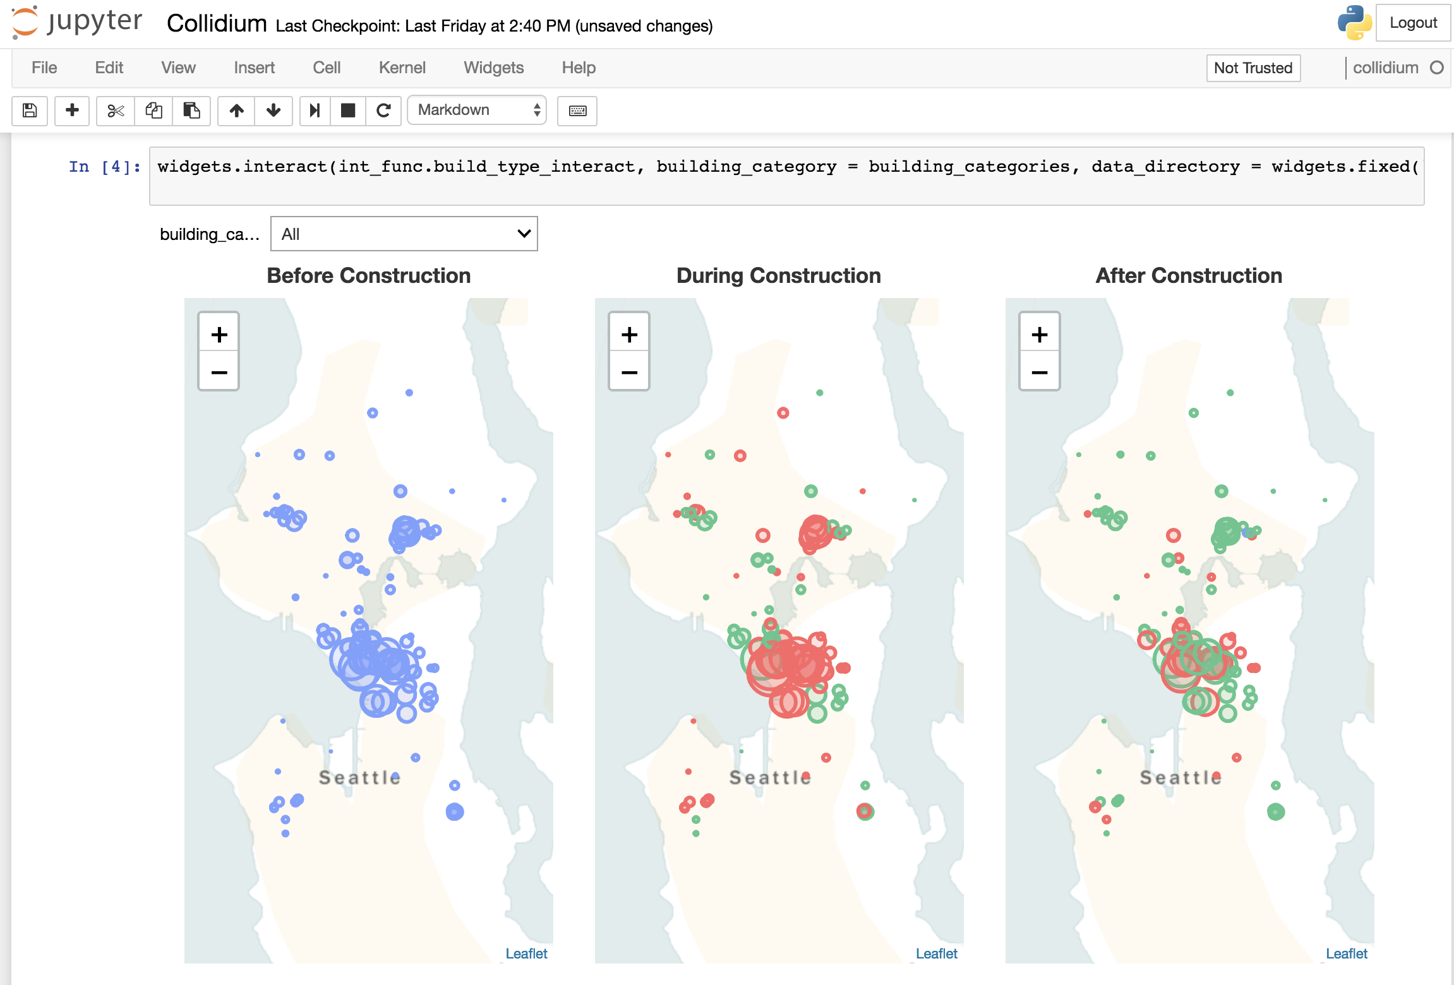
Demo
Collidium: Seattle collision research tool

Slide 5
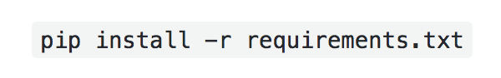
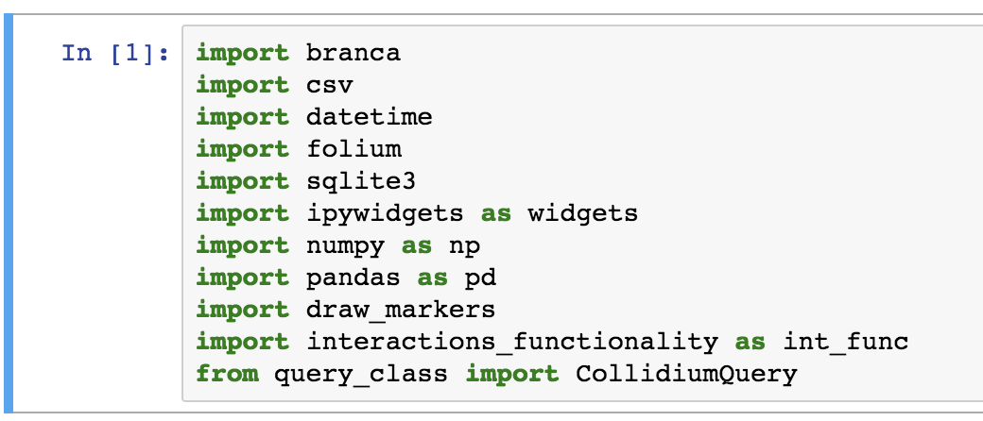
Environment
Collidium: Seattle collision research tool
Compatible with Python 3.5 or later
Users can pip install package requirements or use minimal environment
Package Dependencies
pandas
numpy
branca
folium
ipywidgets
geopy
ipython

Slide 6
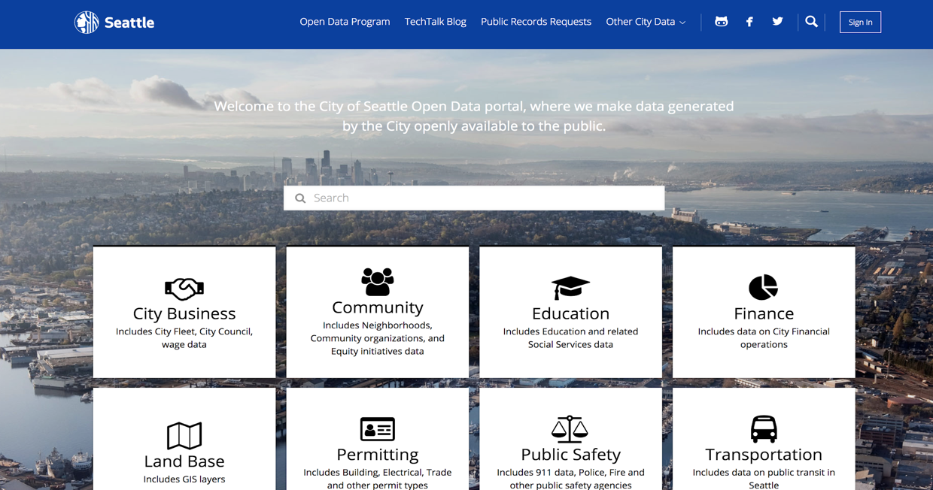
Seattle open data portal
Collidium: Seattle collision research tool

Slide 7
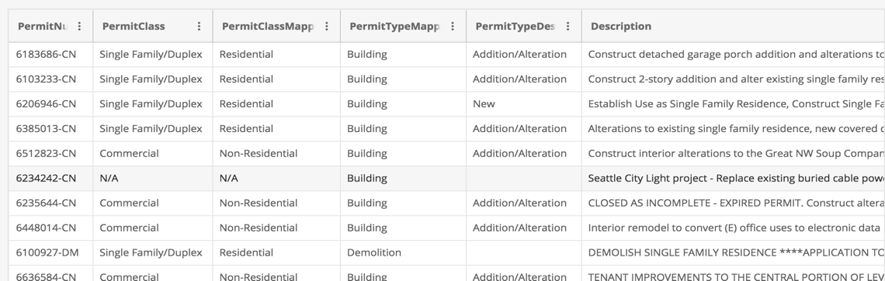
Building Permit Dataset
Collidium: Seattle collision research tool
Contains information on 60,000 building permits (2014-2018)
Collidium only uses permit values greater than $1 million (440 buildings)

Slide 8
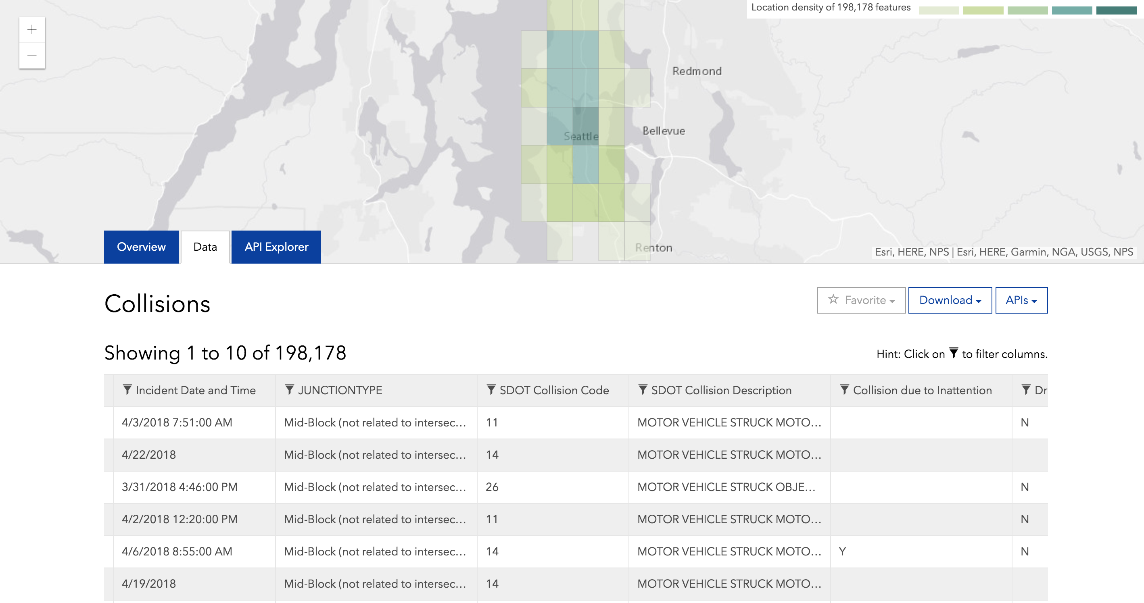
Collisions Dataset
Collidium: Seattle collision research tool
Contains information on nearly 200,000 collisions from 2003-2018
Filtered for collisions occurring 2013 or later, occurring within 1,500 feet and one year of an active building permit

Slide 9
Collidium Database
Collidium: Seattle collision research tool
Collidium Database Construction
Estimate distances between collisions and building permits
Link together collisions and building permits based on criteria
Convert into database, access with SQLite queries when interacting with Folium maps.

Slide 10
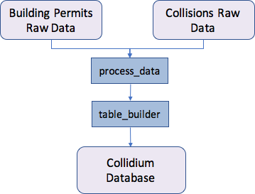
Project Components
Collidium: Seattle collision research tool

Slide 11
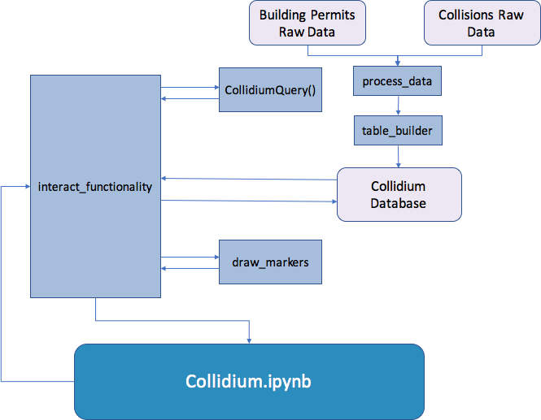
PRoject Components
Collidium: Seattle collision research tool

Slide 12
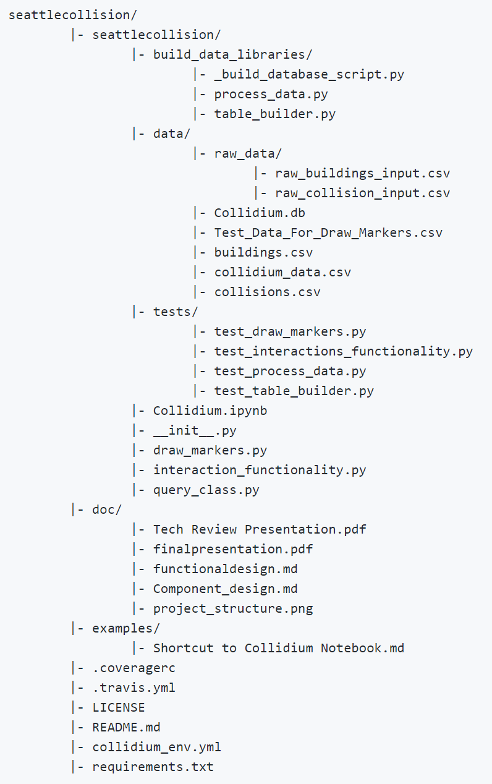
Project Structure
Collidium: Seattle collision research tool
Started with Shablona template.
Packaged database is ready to use but we also included the code to generate it. (Build code is segregated to prevent accidental run).
The main user interface notebook is called Collidium and located in the project directory.
Doc subfolder includes all presentations and design documents.
Examples contains a pointer to the main Jupyter interface.
Environment, Travis files, License (MIT), and README are in root directory.

Slide 13
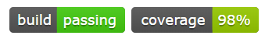
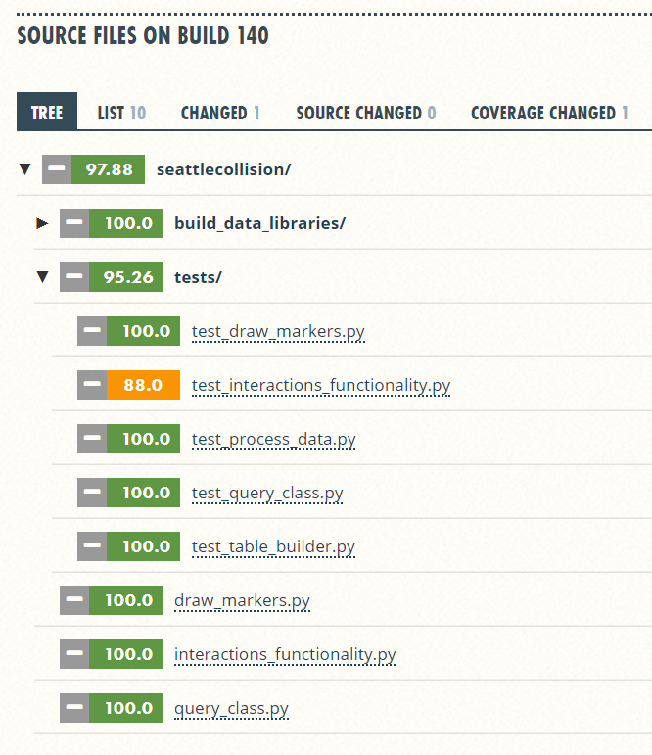
Project Structure – Continuous Integration
Collidium: Seattle collision research tool
Pylint/PEP8
Unittest Coverage
Dependency Checks
Interface requires Python 3.5+
Deprecated method warnings, e.g.: distance calc vincenty
Annoyance: coveralls checks test modules for coverage
User Interface Smoke Tests – otherwise 100%

Slide 14
Lessons learned
Collidium: Seattle collision research tool
Coordination and Collaboration in Git
Folium is an excellent mapping package, but making visualizations can be overly complex and cumbersome
Tradeoffs between pre-processing and on the fly data processing
Travis hangs for a long time when you have lots of commits close together and time-extensive testing (Use [skip ci] in commit message)

Slide 15
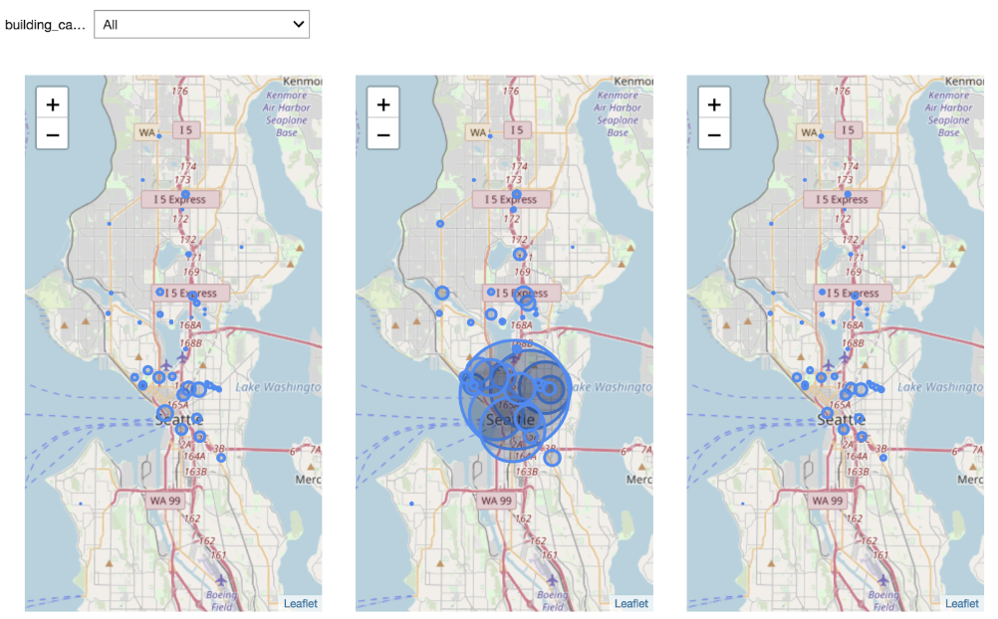
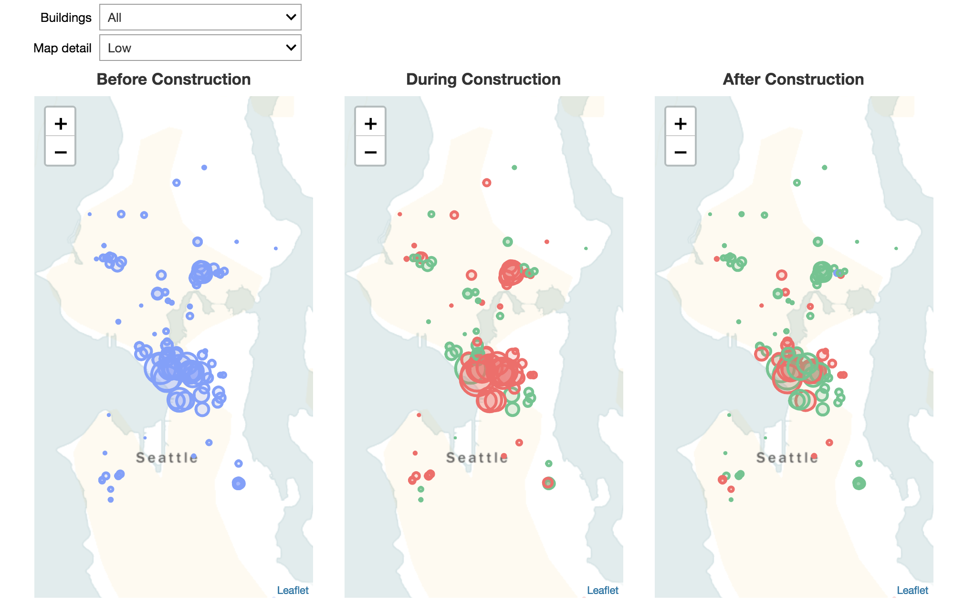
Updates since Last Week
Collidium: Seattle collision research tool
Map detail widget
Color coding to better display increases and decreases in collisions
Added map labeling and legend

Slide 16
Future Work
Collidium: Seattle collision research tool
Interactive, details on demand for specific buildings
Use of statistics to better address the research question, e.g. statistical significance of increase/decrease in collisions, etc.
Explore other types of visualizations to convey changes in collision types
More widget control/styling, adding multiple selects (which is supported by CollidiumQuery)
More object-oriented project structure
Generalize CollidiumQuery args using dictionary structure

Slide 17
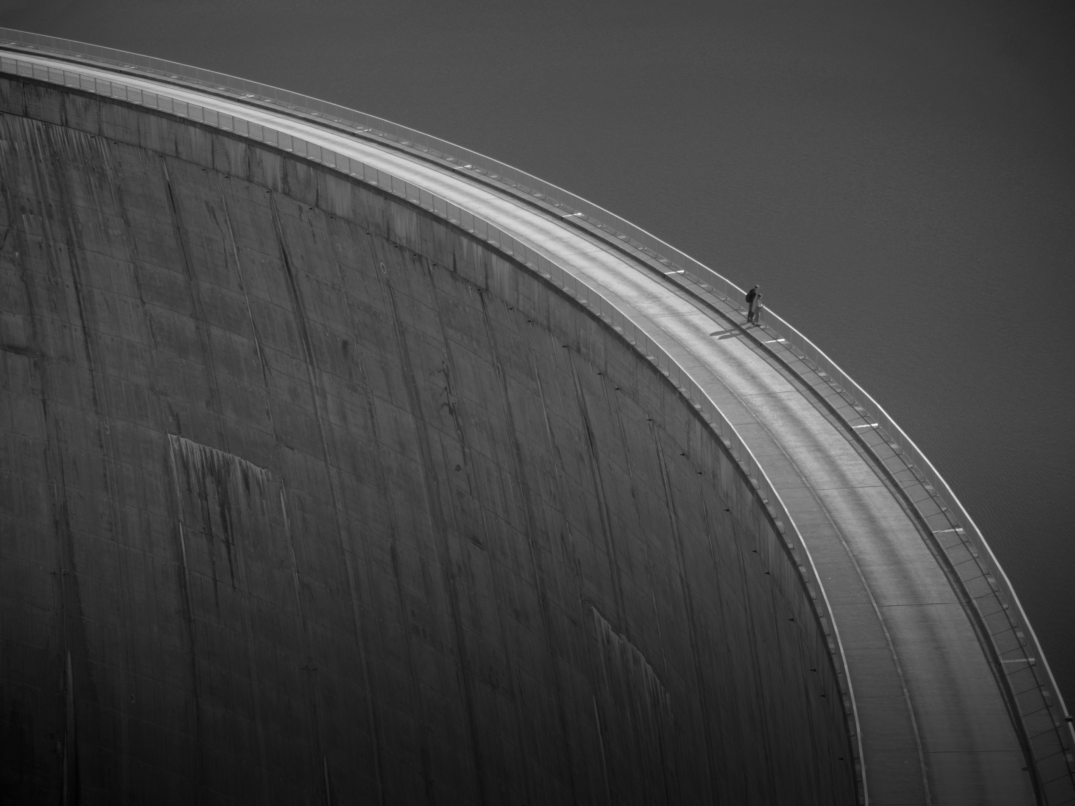
Thank you!

